Slide 1
Engineering Mechanics
Pulley Systems and Associated Work
LabRat Scientific
© 2019

Slide 2
What is Mechanical Work
WORK is done when a FORCE is applied over some DISTANCE.
Work = Force (N) x Distance (m)
The FORCE can come from any number of sources:
Gravity
Wind
Pressure
Springs
Etc…

Slide 3
Work has Direction
WORK can be either positive or negative.
WORK is positive when the force acts in the direction of the movement
Force
WORK is negative when the force acts against the direction of the movement
Force

Slide 4
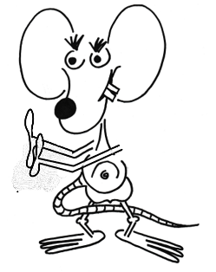
Work has Direction
Example: If Larry is trying to allow the ball to move down the ramp in a slow, controlled manner, he must apply a force to keep it from moving too fast. As such, Larry is doing negative work on the ball…
And gravity is doing positive work…

Slide 5
Pulley Systems
Pulley systems can be used to gain mechanical advantage.
While Configuration A at the right can be used to lift an object, it provides no mechanical advantage.
Configuration B can be used for lifting and it also reduces the force needed to lift the object, thus providing mechanical advantage.
To understand how mechanical advantage is achieved, we need to examine the work done on the block.
Configuration A
Configuration B

Slide 6
Simple Pulley System
Only one sting pulling upward on the Test Block.
Up Force = 4.4 N
For very centimeter the string is pulled down, the block moves up one centimeter.
The tension (force) in the string is equal to the weight of the Test Block.
Pull Force = 4.4 N
Weight = 4.4 N

Slide 7
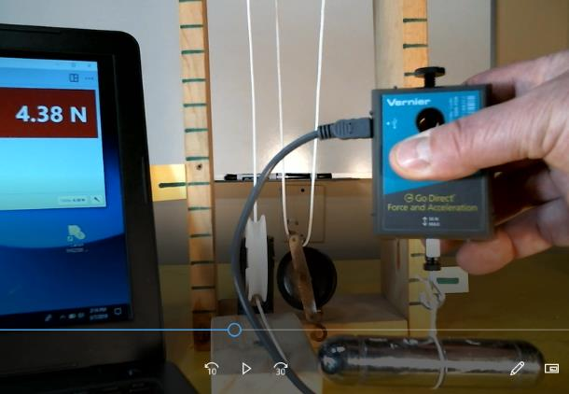
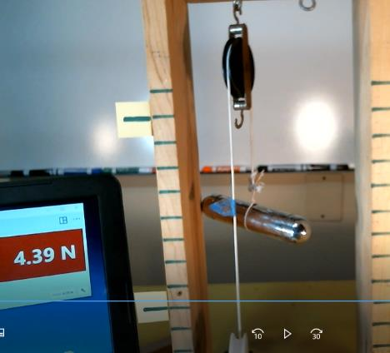
Experimental Verification - Force
The weight of the Test Block
Tension (Force) in the string while the Test Block is supported.
Conclusion: For a single pulley system, the tension (force) in the string is equal to the weight of the Test Block.

Slide 8
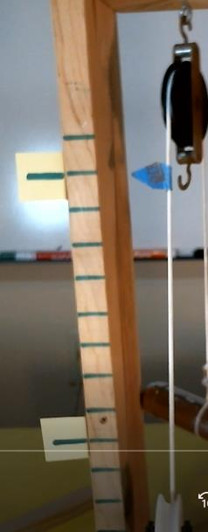
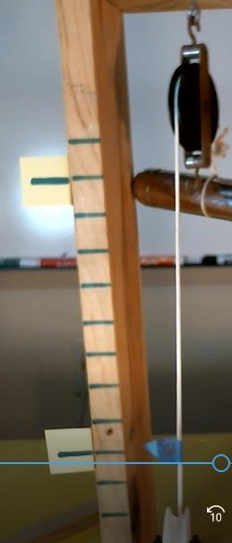
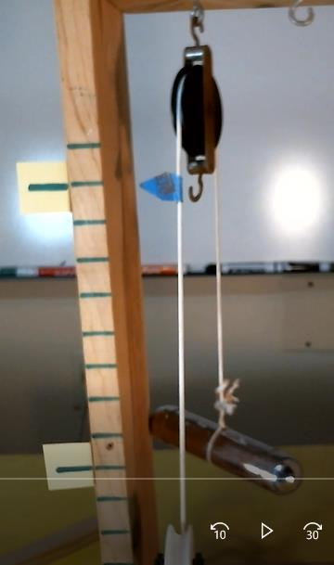
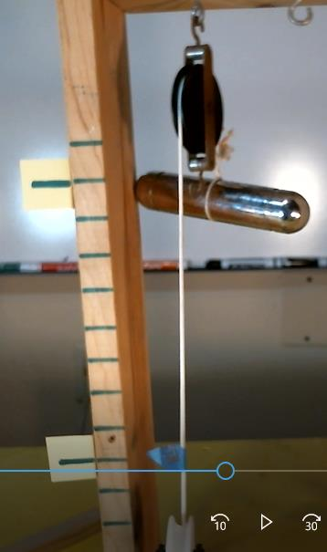
Experimental Verification - Displacement
Conclusion: For a single pulley system, the object being lifted will move a distance that is equal to the length of string pulled through the pulley.

Slide 9
Analyzing a Simple Pulley System
If the downward force applied to the string is equal to the weight of the Test Block, the system will be in static equilibrium and nothing will move. If there is no motion (a.k.a. no displacement) there is no work done.
To get the Test Block to start moving, the string needs to be pulled with a force that is at least slightly greater than the weight of the Test Block.
This creates an unbalanced net force which accelerates the Test Block upwards.
Downward force applied to rope
Weight of the Block

Slide 10
Analyzing a Simple Pulley System
To simplify the assessment, we will just look at the system at the Initial State and the Final State.
B
This way we don’t have to concern ourselves about the unbalanced forces needed to accelerate and decelerate the Test Block.
Distance block moves up
A
Distance rope is pulled down
Initial State
Final State

Slide 11
Analyzing a Simple Pulley System
To simplify the assessment, we will just look at the system at the Initial State and the Final State.
B
This way we don’t have to concern ourselves about the unbalanced forces needed to accelerate and decelerate the Test Block.
4.4 N
0.16 m
A
0.16 m
4.4 N
Initial State
Final State

Slide 12
Analyzing a Simple Pulley System
Experimental parameters:
String Tension (force) = 4.4 N
Test Block Displacement = 0.16 m
The work done by the string force while moving the Test Block from Point-A to Point-B:
Work_{pull} = 4.4 N x 0.16 m = 0.7 Nm
However, this is not the net work done on the system because we also have to look and the block and the weight force. We can’t forget that gravity is pulling down on the block even though it was moving upwards… This is where the “direction” of work comes into play.

Slide 13
Analyzing a Simple Pulley System
We pulled down on the end of the string and the string moved downwards. Keep in mind that when we pull “down” on the string we are also pulling “up” on the block so the force is actually in the direction of motion of the block… Since the work was done in the direction of displacement, this work is positive.
However, on the other end of the string, the weight of the block was pulling downward, yet the block moved upward.
Since the gravity force acting on the block was in the opposite direction of the displacement, the work done by gravity is negative.
Work_{gravity} = 4.4 N x 0.16 m = - 0.7 Nm

Slide 14
Net Work done on the Block
To understand the total net work on the system we have to look at both the work done by our hand and the work done by gravity.
Work_{Net} = Work_{Pull} + Work_{Gravity}
Work_{Net} = 0.7 Nm + (- 0.7 Nm)
Work_{Net} = 0.0 Nm
This is interesting. The net work performed on the block by the string force and gravity is ZERO…

Slide 15
Ignoring the concept of Net Work
We should keep this “net work” concept in the back of our minds, but in reality we are usually concerned with the amount of work we must perform when moving something.
As such, for the remainder of this lesson we will only concern ourselves with the work done by pulling on the string (which then pulls on the block)…
Student Thought Experiment: How does the concept of “net work” apply to a block being pulled from Point-A to Point-B on a horizontal frictionless table?

Slide 16
Gaining Mechanical Advantage with a Pulley System
A Free Body Diagram (FBD) is used to help us analyze more complicated systems. The FBD depicts the forces acting on a body.
The tension (force) in the rope can be assessed by drawing a FBD of the block and the two strings attached to it.
Up Force
Up Force
The upward forces will be equal to one another.
Weight = mg

Slide 17
Gaining Mechanical Advantage with a Pulley System
If we assume the system is in static equilibrium (i.e. forces are balanced and the block is not moving) we can say the downward force is equal to the sum of the upward forces.
Up Force
Up Force
Forces_{Down} = Forces_{Up}
4.4 N = Force1_{Up} + Force2_{Up}
Weight = mg
Weight = 4.4 N
Since Force1_{Up} = Force2_{Up}
4.4 N = 2 Force_{Up}
Force_{Up} = 2.2 N

Slide 18
Forces Acting on the Block
2.2 N
2.2 N
This diagram shows that the “tension” in the string is 2.2 N everywhere along the string.
2.2 N
2.2 N
4.4 N
Pull Force = 2.2 N
FBD of the Block
Weight = 4.4 N

Slide 19
Gaining Mechanical Advantage with a Pulley System
This analysis tells us we can lift the 4.4 N block by only applying a 2.2 N pull on the string (actually a smidgen more to actually move the block upwards…).
Let’s look at the work. As with the simple pulley system shown in an earlier slide, let’s pull on the string to lift the block 0.16 m…
How far down do we have to pull the end of the string in order to get the block to move upward 0.16 m?
Pull Force = 2.2 N
Weight = 4.4 N

Slide 20
What’s Going On?
The work done is the amount of work that is required to lift the block 0.16 meters (W = F x d). Regardless of the pulley configuration used, if we raise the block the same distance, the same amount of work will be done.
As such:
Work_{Simple Pulley} = Work_{Complex Pulley}
With the more complex pulley system, we determined that the pull force that needs to be applied to the string is only 2.2 N (rather than 4.4 N for the simple pulley). If the work that must be done is the same in each case, we are going to have to have a greater “distance” associated with the smaller force…

Slide 21
Work Done to Lift an Object a Specific Height
0.16 m
Pull Force
= 4.4 N
0.16 m
Distance ?
Pull Force
= 2.2 N
Weight = 4.4 N
Weight = 4.4 N
Work_{Simple} = 4.4 N x 0.16 m = 0.7 Nm
Work_{Complex} = 2.2 N x Distance = 0.7 Nm

Slide 22
Amount of string that needs to be pulled
Work_{pull} = 2.2 N x Distance = 0.7 Nm
2.2 N x Distance = 0.7 Nm
0.7 Nm
Distance = -----------
2.2 N
Distance = 0.32 m
This tells us that we need to pull the string down 0.32 m in order to raise the block 0.16 m. So, when we halve the required pull force, the distance over which we have to apply that force is doubled.

Slide 23
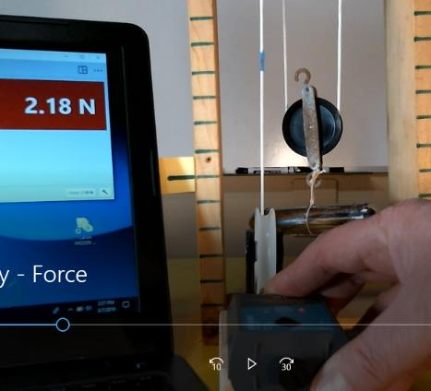
Experimental Verification - Force
The weight of the Test Block
Tension (Force) in the string while the Test Block is supported.
Conclusion: For a dual pulley system, the tension (force) in the string is one half of the weight of the Test Block.

Slide 24
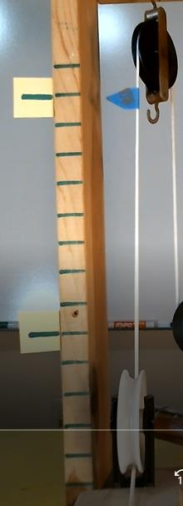
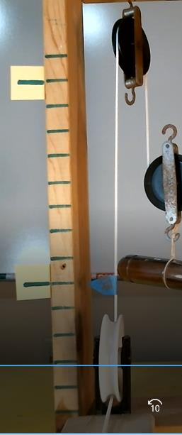
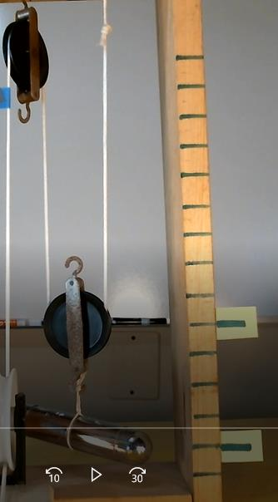
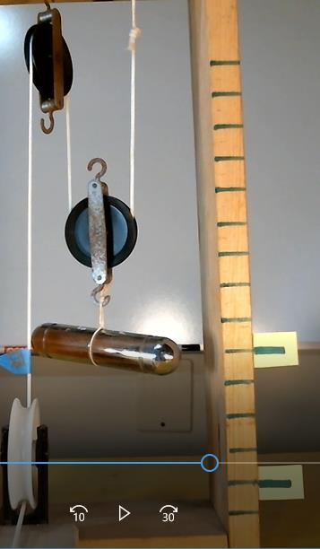
Experimental Verification - Displacement
Conclusion: For a dual pulley system, the string pulled through the pulley will be twice the distance the object if lifted.

Slide 25
Force Diagrams for both pulley configurations. They display the pull force required and the length of string pulled.

Slide 26
The area under the Force Curve is the work that was done.
Notice that the area is the same for each diagram.
Area = Work
Area = 4.4 N x 0.16 m
Area = 0.7 Nm = Work
Area = Work
Area = 2.2 N x 0.32 m = 0.7 Nm = Work

Slide 27
CONCLUSION:
A pulley system can be used to reduce the amount of FORCE needed to lift an object, but the amount of WORK that needs to be done remains constant with respect to lifting a specific load to a specific height…

Slide 28
An even more complex pulley configuration…
Each Force = 5.0 N / 4 = 1.25 N
5 N
Using the computational logic outlined in this lesson, the 4 upward forces in the FBD would be 1.25 N each. This means that the required pull force is only 1.25 N. But, 4x the amount of string has to be pulled as compared to the simple pulley system.

Slide 29
Questions ?

